Slide 1
Software Engineering [CS3CO026]
Course Teacher : Ms Priyanka Dhasal

Slide 2
Index
Software Engineering – Definition, Process, Evolution and Myths
Generic Process Model
Framework
Process Models – Waterfall Model
Incremental
Evolutionary Model
Spiral Model
Component Based Model
Rational Unified Process

Slide 3
Introduction
Software is more than just a program code. A program is an executable code, which serves some computational purpose.
Software is considered to be collection of executable programming code, associated libraries and documentations.
Software, when made for a specific requirement is called software product.

Slide 4
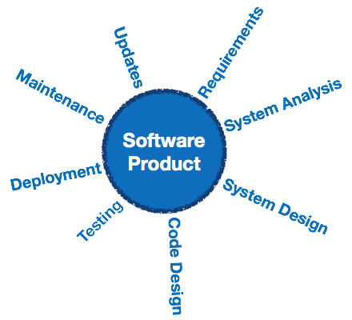
Engineering on the other hand, is all about developing products, using well-defined, scientific principles and methods.

Slide 5
Software engineering is an engineering branch associated with development of software product using well-defined scientific principles, methods and procedures.
The outcome of software engineering is an efficient and reliable software product.

Slide 6
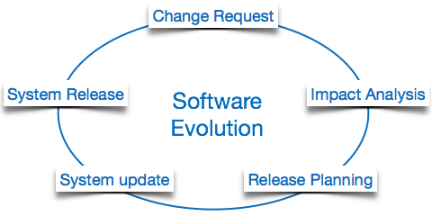
Software Evolution

Slide 7
The process of developing a software product using software engineering principles and methods is referred to as software evolution.
This includes the initial development of software and its maintenance and updates, till desired software product is developed, which satisfies the expected requirements.
Evolution starts from the requirement gathering process. After which developers create a prototype of the intended software and show it to the users to get their feedback at the early stage of software product development.
The users suggest changes, on which several consecutive updates and maintenance keep on changing too. This process changes to the original software, till the desired software is accomplished.

Slide 8
Even after the user has desired software in hand, the advancing technology and the changing requirements force the software product to change accordingly.
Re-creating software from scratch and to go one-on-one with requirement is not feasible.
The only feasible and economical solution is to update the existing software so that it matches the latest requirements.

Slide 9
Need of Software Engineering
The need of software engineering arises because of higher rate of change in user requirements and environment on which the software is working.
Large software - It is easier to build a wall than to a house or building, likewise, as the size of software become large engineering has to step to give it a scientific process.
Scalability- If the software process were not based on scientific and engineering concepts, it would be easier to re-create new software than to scale an existing one.
Cost- As hardware industry has shown its skills and huge manufacturing has lower down he price of computer and electronic hardware. But the cost of software remains high if proper process is not adapted.

Slide 10
Dynamic Nature- The always growing and adapting nature of software hugely depends upon the environment in which user works. If the nature of software is always changing, new enhancements need to be done in the existing one. This is where software engineering plays a good role.
Quality Management- Better process of software development provides better and quality software product.

Slide 11
Characteristics of good software
A software product can be judged by what it offers and how well it can be used. This software must satisfy on the following grounds:
Operational
Transitional
Maintenance
Well-engineered and crafted software is expected to have the following characteristics:

Slide 12
Operational
This tells us how well software works in operations. It can be measured on:
Budget
Usability
Efficiency
Correctness
Functionality
Dependability
Security
Safety

Slide 13
Transitional
This aspect is important when the software is moved from one platform to another:
Portability
Interoperability
Reusability
Adaptability
Maintenance
This aspect briefs about how well a software has the capabilities to maintain itself in the ever-changing environment:
Modularity
Maintainability
Flexibility
Scalability

Slide 14
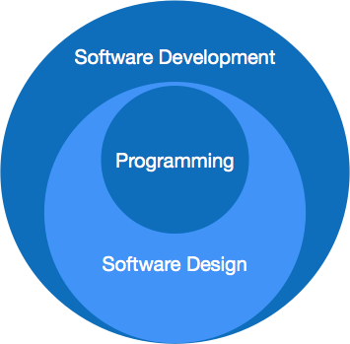
Fig - Software Paradigm

Slide 15
Generic Process Model
Software Process
A software process (also knows as software methodology) is a set of related activities that leads to the production of the software.
These activities may involve the development of the software from the scratch, or, modifying an existing system.

Slide 16
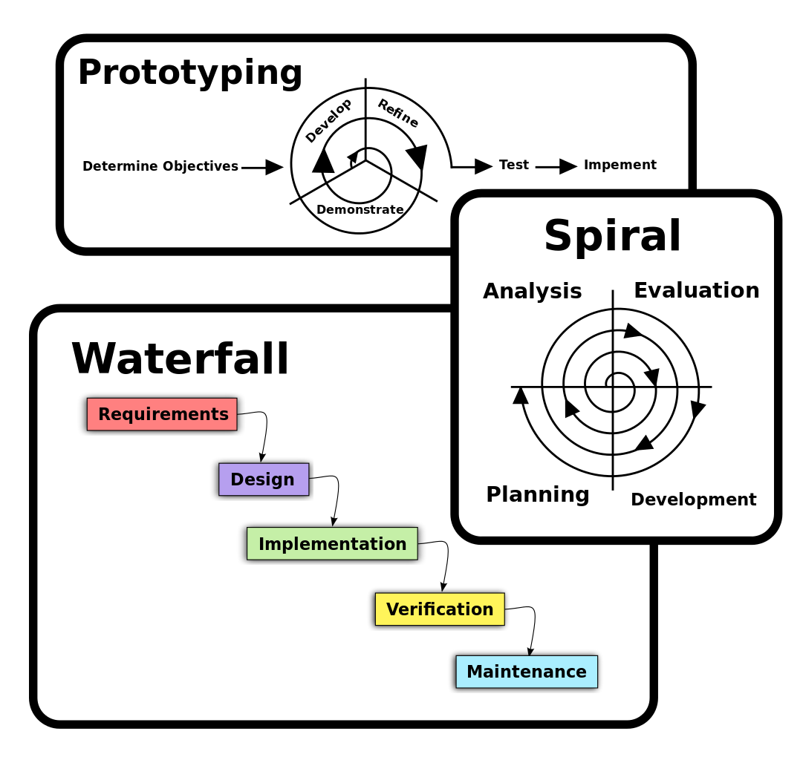

Slide 17
Any software process must include the following four activities:
Software specification (or requirements engineering): Define the main functionalities of the software and the constrains around them.
Software design and implementation: The software is to be designed and programmed.
Software verification and validation: The software must conforms to it’s specification and meets the customer needs.
Software evolution (software maintenance): The software is being modified to meet customer and market requirements changes.

Slide 18
A process description is given as:
Products: The outcomes of the an activity. For example, the outcome of architectural design maybe a model for the software architecture.
Roles: The responsibilities of the people involved in the process. For example, the project manager, programmer, etc.
Pre and post conditions: The conditions that must be true before and after an activity. For example, the pre condition of the architectural design is the requirements have been approved by the customer, while the post condition is the diagrams describing the architectural have been reviewed.

Slide 19
Software Process Models
A software process model is an abstract representation of a process that presents a description of a process from some particular perspective. There are many different software processes but all involve:
Specification – defining what the system should do;
Design and implementation – defining the organization of the system and implementing the system;
Validation – checking that it does what the customer wants;
Evolution – changing the system in response to changing customer needs.

Slide 20
Types of Software Process Model
Waterfall model
V model
Incremental model
RAD model
Agile model
Iterative model
Spiral model
Prototype model

Slide 21
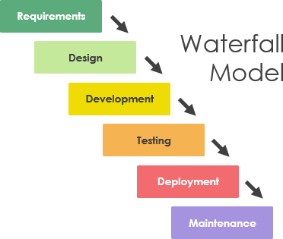
Waterfall model

Slide 22
The Waterfall Model was the first Process Model to be introduced. It is very simple to understand and use.
In a Waterfall model, each phase must be completed before the next phase can begin and there is no overlapping in the phases.
The waterfall model is the earliest SDLC approach that was used for software development.

Slide 23
The sequential phases in Waterfall model are −
Requirement Gathering and analysis − All possible requirements of the system to be developed are captured in this phase and documented in a requirement specification document.
System Design − The requirement specifications from first phase are studied in this phase and the system design is prepared. This system design helps in specifying hardware and system requirements and helps in defining the overall system architecture.
        Implementation − With inputs from the system design, the system is first developed in small programs called units, which are integrated in the next phase. Each unit is developed and tested for its functionality, which is referred to as Unit Testing.

Slide 24
Integration and Testing − All the units developed in the implementation phase are integrated into a system after testing of each unit. Post integration the entire system is tested for any faults and failures.
Deployment of system − Once the functional and non-functional testing is done; the product is deployed in the customer environment or released into the market.
Maintenance − There are some issues which come up in the client environment. To fix those issues, patches are released. Also to enhance the product some better versions are released. Maintenance is done to deliver these changes in the customer environment.

Slide 25
Applications
Requirements are very well documented, clear and fixed.
Product definition is stable.
Technology is understood and is not dynamic.
There are no ambiguous requirements.
Ample resources with required expertise are available to support the product.
The project is short.

Slide 26
Advantages
Simple and easy to understand and use
Easy to manage due to the rigidity of the model. Each phase has specific deliverables and a review process.
Phases are processed and completed one at a time.
Works well for smaller projects where requirements are very well understood.
Clearly defined stages.
Well understood milestones.
Easy to arrange tasks.
Process and results are well documented.

Slide 27
Disadvantages
No working software is produced until late during the life cycle.
High amounts of risk and uncertainty.
Not a good model for complex and object-oriented projects.
Poor model for long and ongoing projects.
Not suitable for the projects where requirements are at a moderate to high risk of changing. So, risk and uncertainty is high with this process model.
It is difficult to measure progress within stages.
Cannot accommodate changing requirements.
Adjusting scope during the life cycle can end a project.

Slide 28
Integration is done as a "big-bang. at the very end, which doesn't allow identifying any technological or business bottleneck or challenges early.

Slide 29
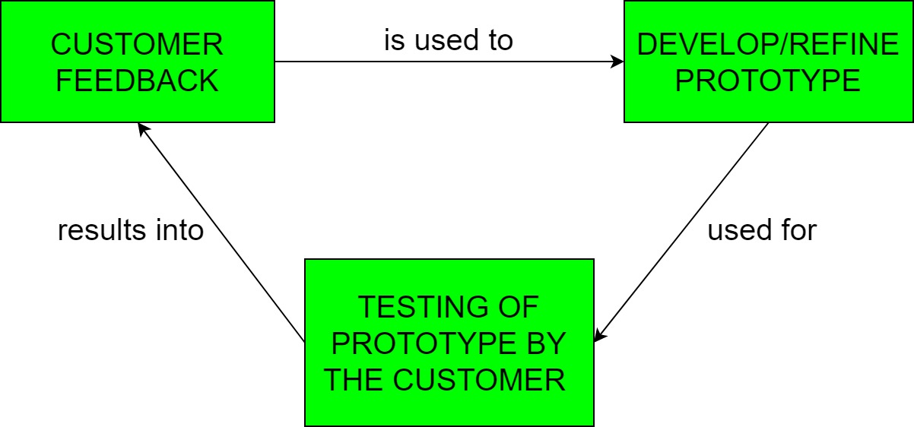
Prototyping Model
Prototyping is defined as the process of developing a working replication of a product or system that has to be engineered. It offers a small scale facsimile of the end product and is used for obtaining customer feedback .

Slide 30
The Prototyping Model is one of the most popularly used Software Development Life Cycle Models (SDLC models).
This model is used when the customers do not know the exact project requirements beforehand.
In this model, a prototype of the end product is first developed, tested and refined as per customer feedback repeatedly till a final acceptable prototype is achieved which forms the basis for developing the final product.
In this process model, the system is partially implemented before or during the analysis phase thereby giving the customers an opportunity to see the product early in the life cycle.
The process starts by interviewing the customers and developing the incomplete high-level paper model. This document is used to build the initial prototype supporting only the basic functionality as desired by the customer.

Slide 31
Once the customer figures out the problems, the prototype is further refined to eliminate them.
The process continues till the user approves the prototype and finds the working model to be satisfactory.
In this process model, the system is partially implemented before or during the analysis phase thereby giving the customers an opportunity to see the product early in the life cycle.

Slide 32
The process starts by interviewing the customers and developing the incomplete high-level paper model.
This document is used to build the initial prototype supporting only the basic functionality as desired by the customer.
Once the customer figures out the problems, the prototype is further refined to eliminate them.
The process continues till the user approves the prototype and finds the working model to be satisfactory.

Slide 33
Advantages
The customers get to see the partial product early in the life cycle. This ensures a greater level of customer satisfaction and comfort.
New requirements can be easily accommodated as there is scope for refinement.
Missing functionalities can be easily figured out.
Errors can be detected much earlier thereby saving a lot of effort and cost, besides enhancing the quality of the software.
The developed prototype can be reused by the developer for more complicated projects in the future.
Flexibility in design.

Slide 34
Disadvantages
Costly with respect to time as well as money.
There may be too much variation in requirements each time the prototype is evaluated by the customer.
Poor Documentation due to continuously changing customer requirements.
It is very difficult for the developers to accommodate all the changes demanded by the customer.
There is uncertainty in determining the number of iterations that would be required before the prototype is finally accepted by the customer.
After seeing an early prototype, the customers sometimes demand the actual product to be delivered soon.

Slide 35
Applications
Developers in a hurry to build prototypes may end up with sub-optimal solutions.
The customer might lose interest in the product if he/she is not satisfied with the initial prototype.
Used for developing user interfaces
High technology software-intensive systems
Systems with complex algorithms and interfaces

